Slide 1
Primary v. Secondary Sources
https://www.youtube.com/watch?v=pup5eVSbGkE

Slide 2
Flocabulary
https://www.youtube.com/watch?v=k2Vwk4C6Scw

Slide 3
Primary Sources
A primary source is direct evidence of an event, idea, period or development.
It is an oral or written account from ACTUAL PARTICIPANTS or OBSERVERS of an event
THEY WERE THERE
Examples:
Official documents
Speeches and interviews
Diaries and letters
Autobiographies
Advertisements and posters
Physical objects (tools, dishes, art, photographs, statues, videos or pictures)

Slide 4
Secondary Sources
A secondary source interprets and analyzes primary sources
The person writing/creating it WAS NOT THERE
They did not witness the event with their own eyes
Examples:
A journal/magazine articles that interpret previous findings
A history textbook

Slide 5
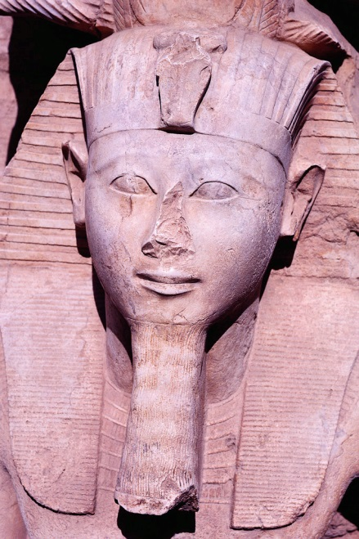
How Do I Tell the Difference?
Primary source: the person had to be there at the time the event happened
Secondary source: studies and interprets the primary source

Slide 6
Is everything HISTORY?
Pre-History:
The history of humans BEFORE the development of writing
History:
The history of humans AFTER the development of writing

